Slide 1
SensoStep Plantar Pressure Sensor
Final Project: Cornerstone of Engineering
Angela Gross, Sally Dorer, Tori Christianson, Emaan Jivani, Mohak Kothari

Slide 2
Why this product?
We wanted to create an analysis tool device for those with issues in their feet to watch the pressure in their foot due to various medical/athletic reasonings
Could be used by powerlifters(squat) to check pressure across foot for optimal performance or runners to check the pressure depending on how they strike when running.
If you have a limp, trouble balancing, or other plantar issues, our goal is for SensoStep to help make them clear to understand and get the help you need.

Slide 3
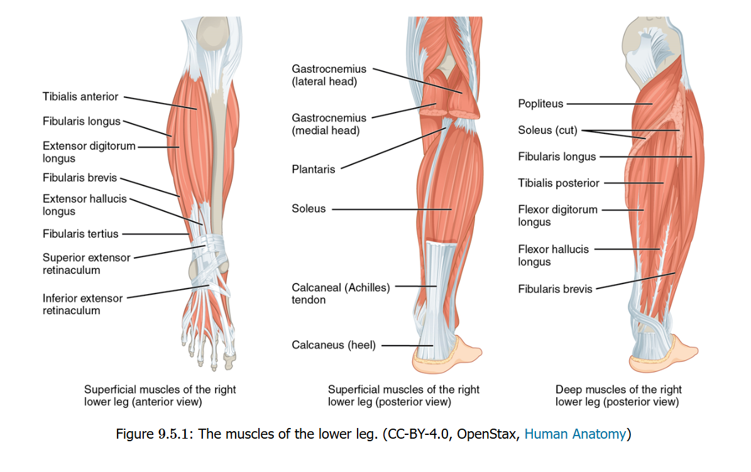
Overuse Injuries
Achilles tendinopathy – pain swelling impaired function
Shin splints – periostitis along the medial tibia
Caused by increased pressure in the deep posterior compartment of the leg

Slide 4
Flat Footedness
Flat footedness can lead to muscle imbalances, and degenerative effects of the lower limb and spine
Increased risk of injury/pain from activity → can lead to decreased activity
Risk factors: family history, BMI over 30, urban residence, the use of footwear in infancy, age, being male

Slide 5
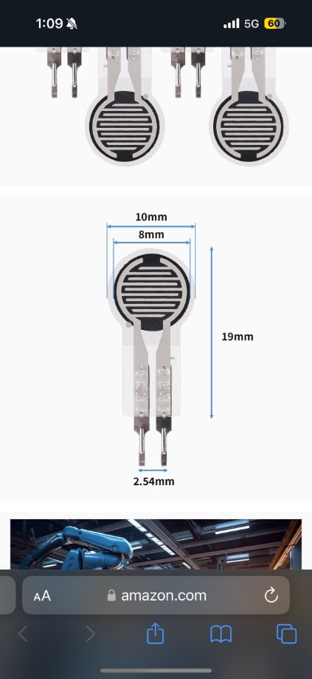
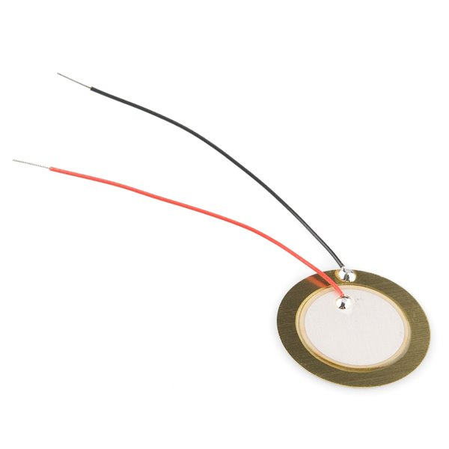
Our Sensors: Force Sensing Resistor
Invented 1977
Comprised of an active area and a conductive area
Pressure changes resistance → sensor outputs data
Hex – representation of sensor data using base 16 numbering

Slide 6
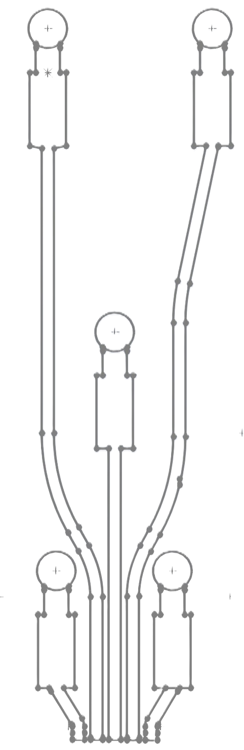
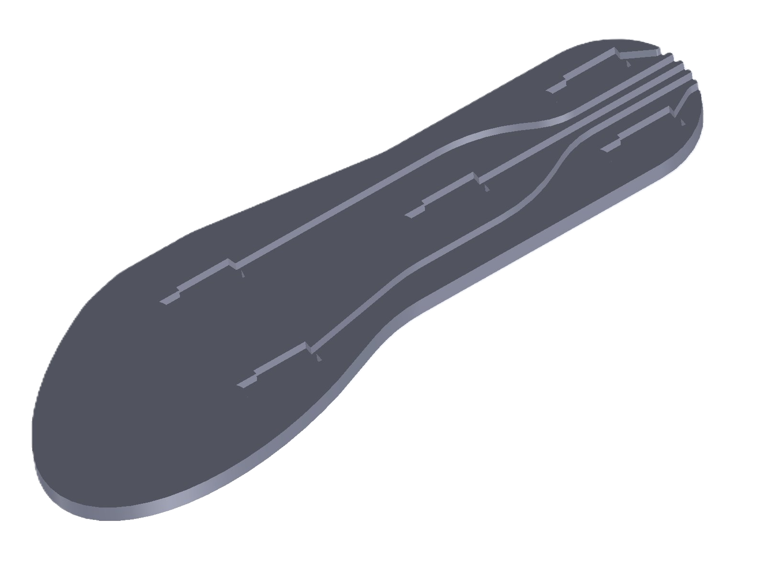
Inserting Wires
Wiring components are protected by hard plastics, leaving only the sensors pads on the outside
Keeps pressure off delicate components
Allows for the wires to travel through the sole without the user feeling
Organizes wires - All wires come out in the same area

Slide 7
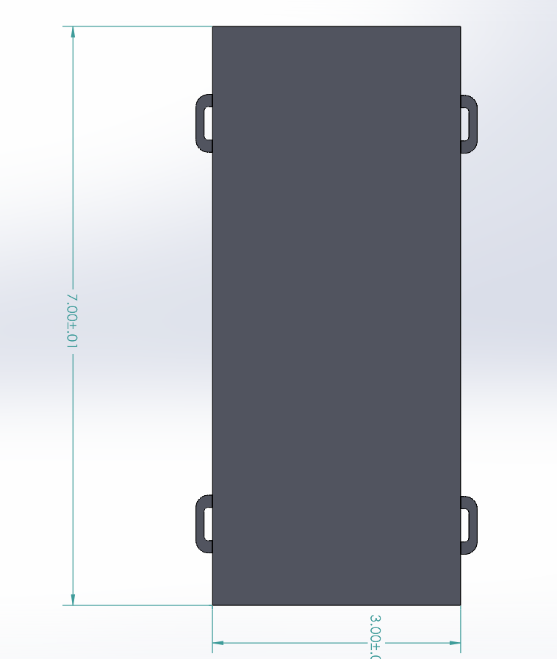
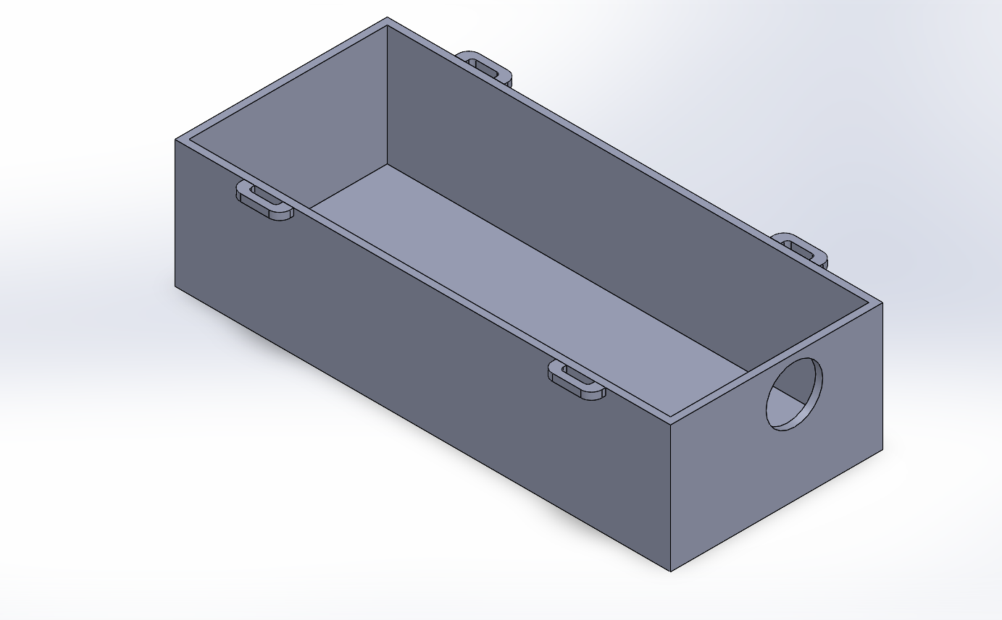
Wire Box

Slide 8
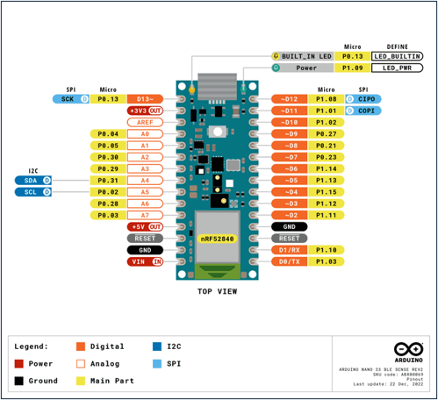
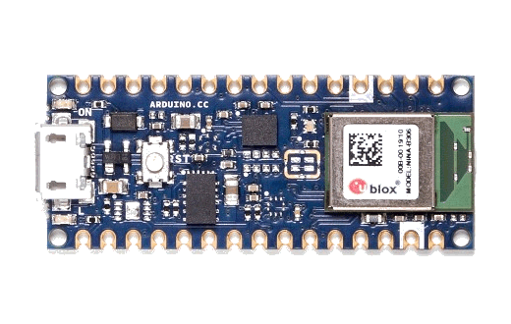
Data Collection- ArduinoBLE
BLE- "Bluetooth Low Energy"
Optimal for low data processing and best option for our project, as the data that we are receiving is not that complex

Slide 9
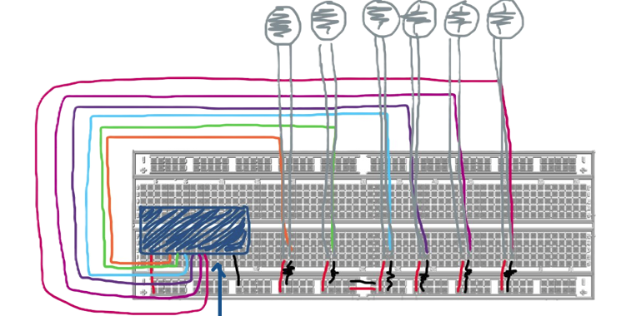
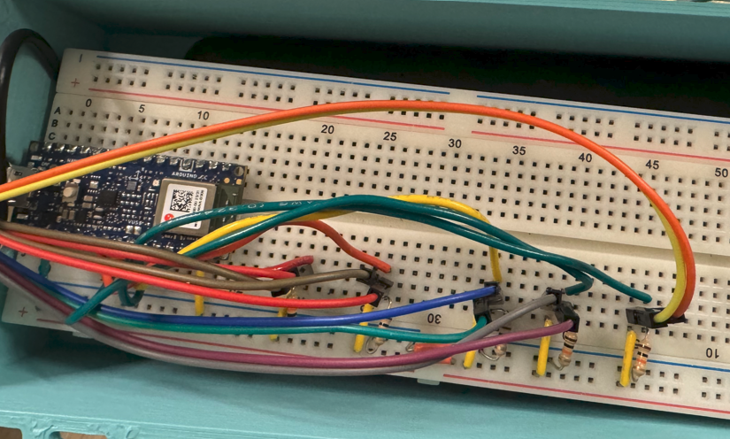
Final Circuitry Assembly
Using resistance pressure sensors, which provide a direct reading of the pressure on a scale of 0 to 1024 (bytes), which is better for the following reasons:
#1: They plot much smoother
#2: They are much more sensitive and accurate
#3: They are flexible and versatile, not easily broken unlike the piezo sensors we opted for before
Measuring each sensor output via analog A1-A5, then via bluetooth

Slide 10
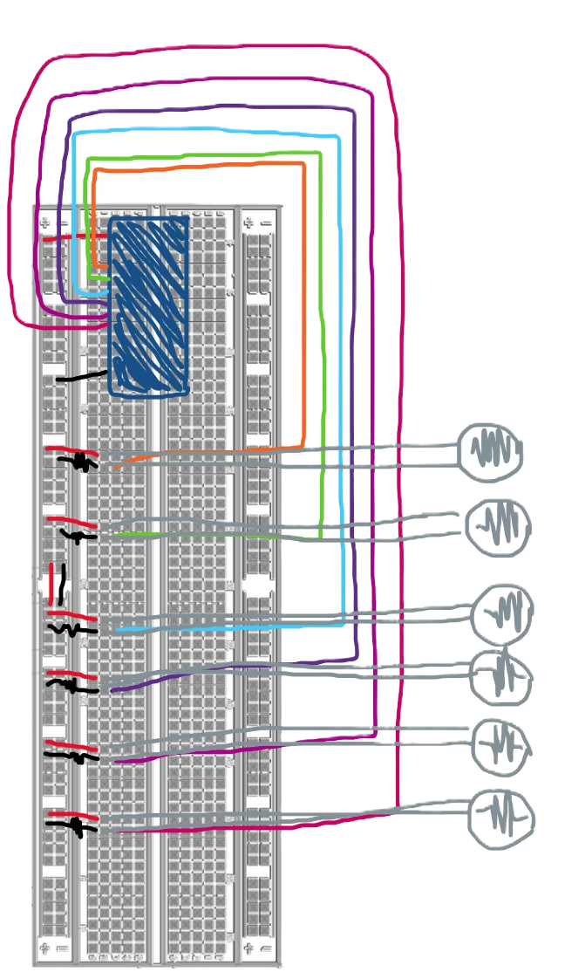
ArduinoBLE
ArduinoBLE- purchased from Arduino website for $26.30
Uses Bluetooth to communicate with each of the sensor inputs
Requires power, which will be resolved with a portable charger with USB port
Issues encountered where the circuit does not draw enough power to keep the battery on and turns off in ~90 seconds.

Slide 11
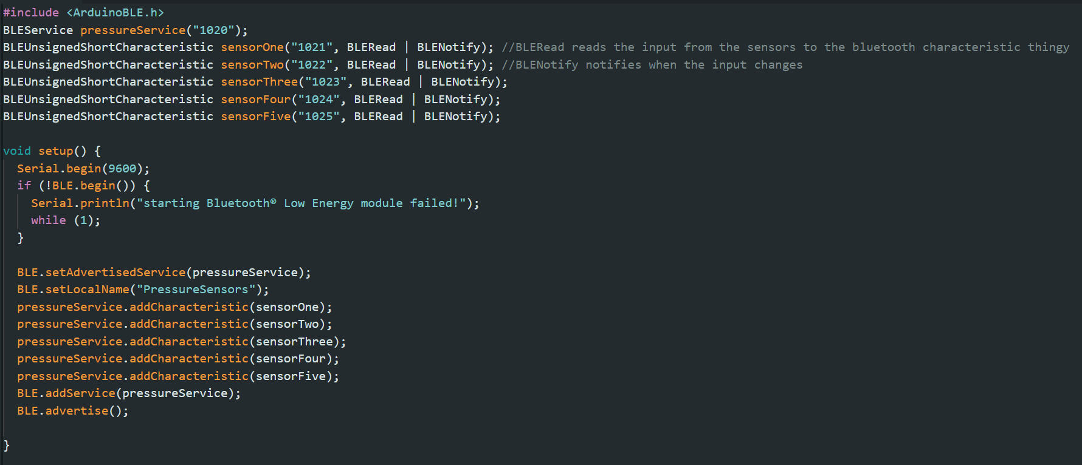
Programming the ArduinoBLE
Declaring/Creating the ArduinoBLE SERVICE
Declaring/Creating the ArdunioBLE CHARACTERISTICS with universal unique identifiers (UUIDS)
Setting up the Serial Monitor and starting the ArdunioBLE, also adding a condition if it fails to start up
Adding all the declared CHARACTERISTICS to the declared SERVICE, and then ADVERTISING the service (making it be seen publicly)

Slide 12
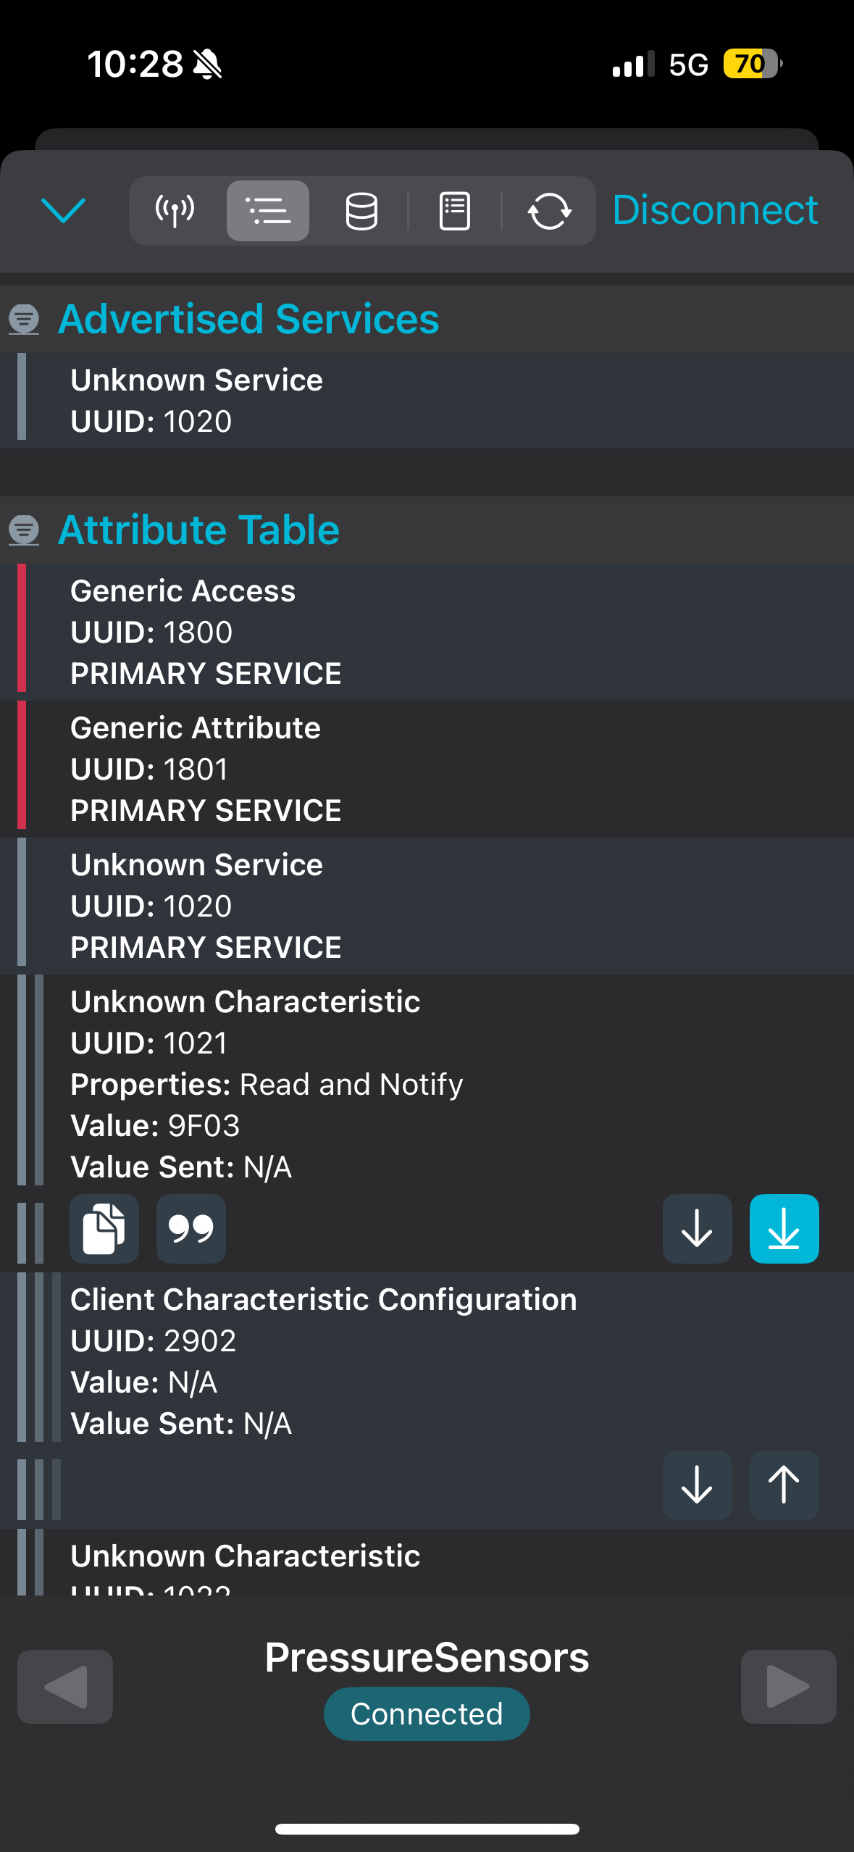
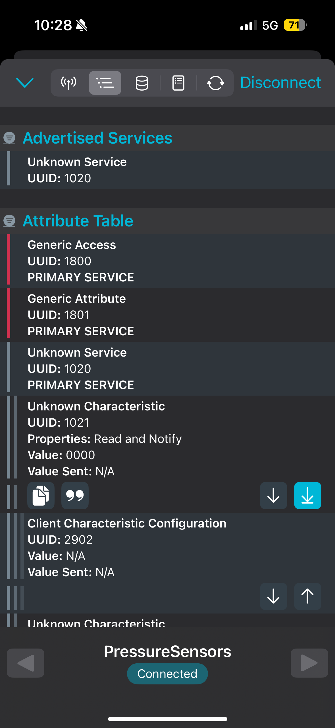
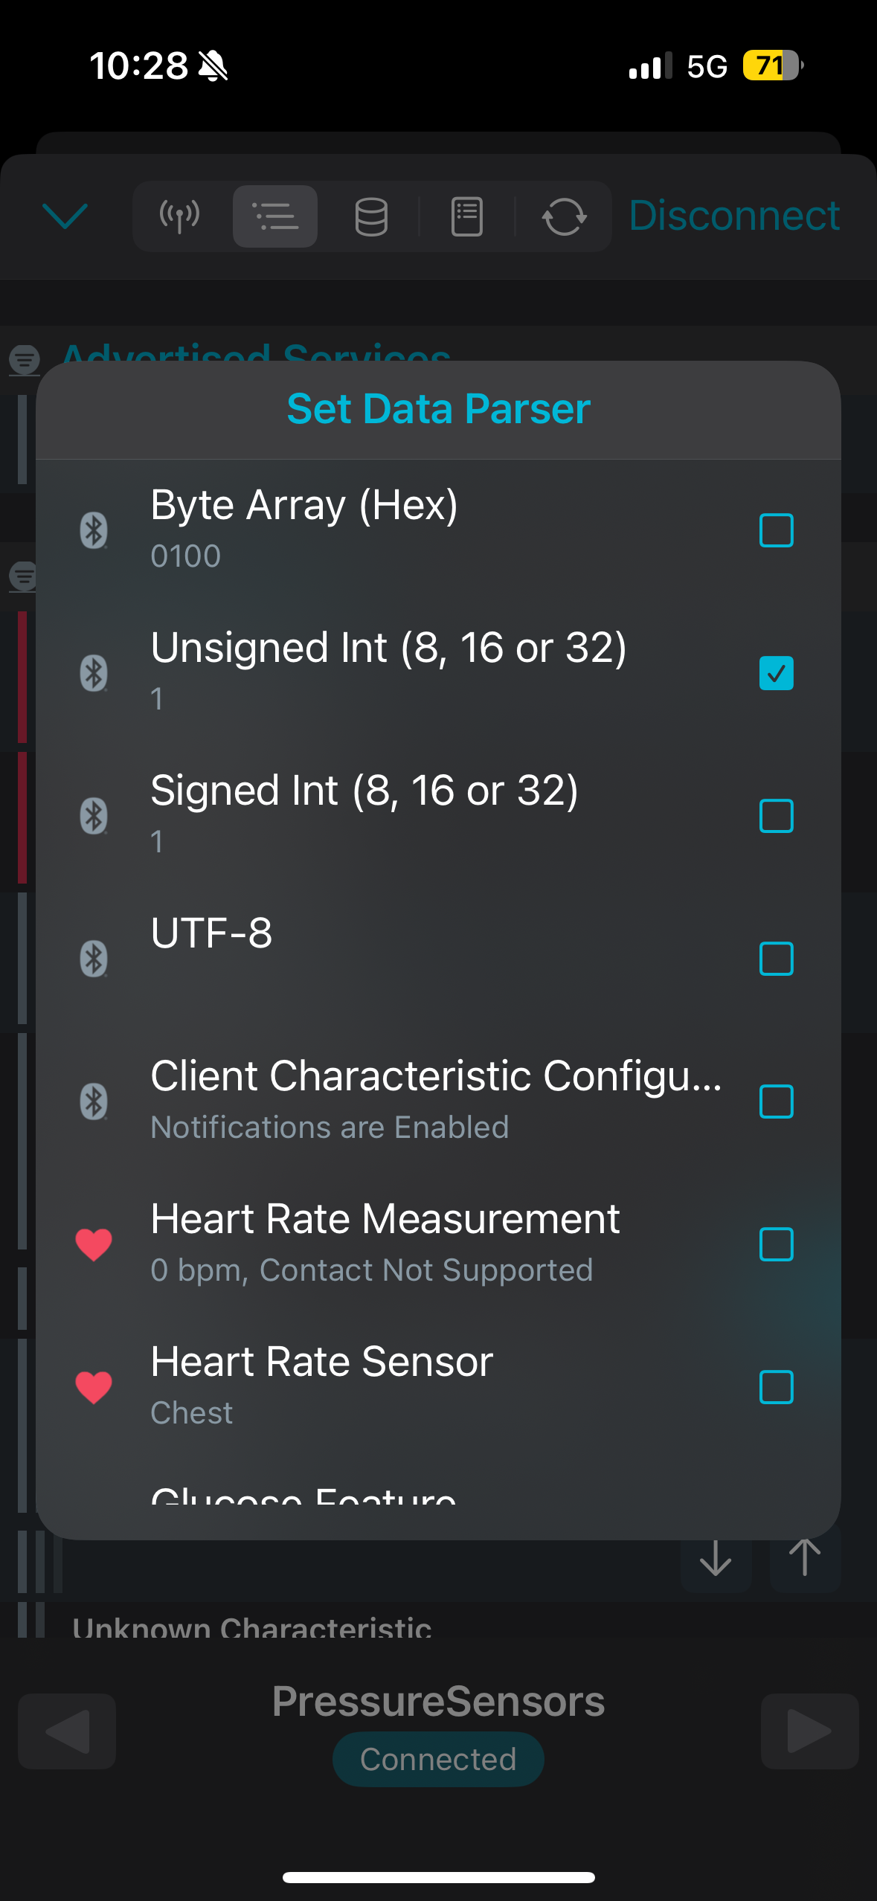
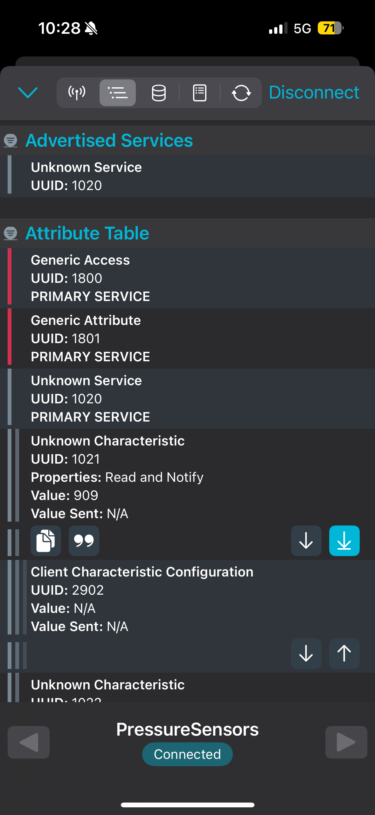




Connecting to Generic Bluetooth App
Since the BLE is advertising, any generic Bluetooth app will be able to pick it up and connect to it
Must enable NOTIFICATIONS (data values will change with new info) every time it is used, and the display value has to be changed from hex to decimal
While this method does receive our data, we wanted an easier and clearer way of displaying our data

Slide 13
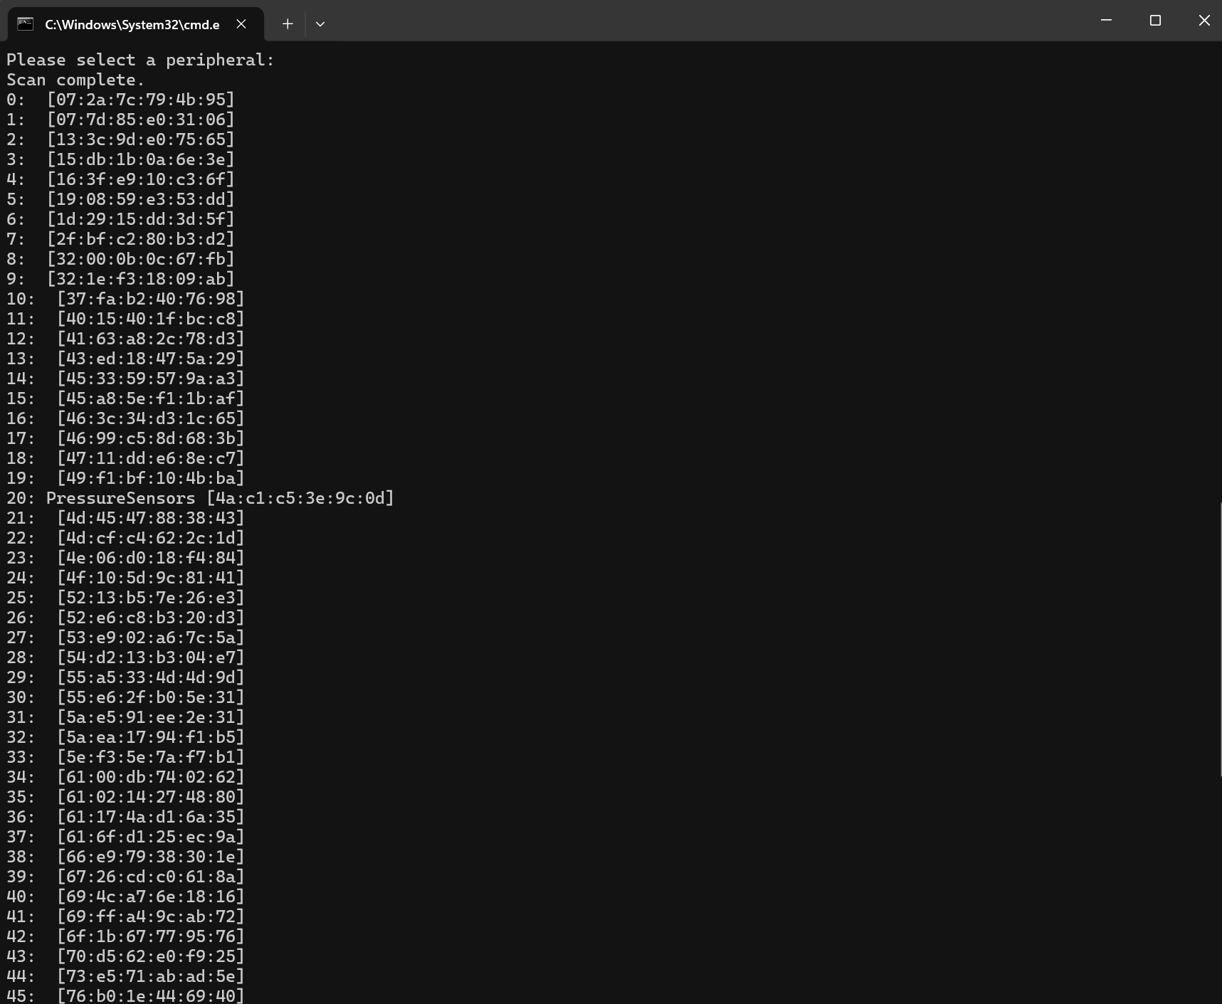
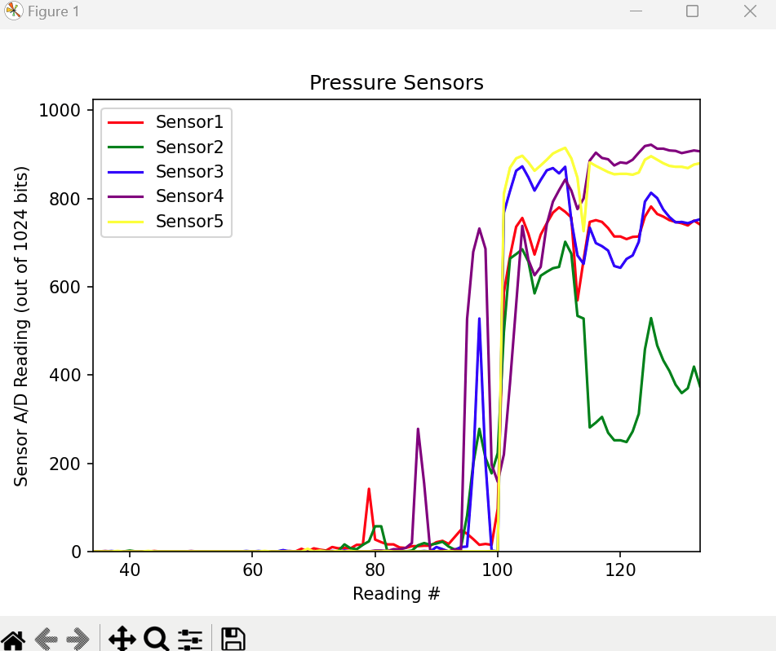
Connecting to Python
Imported 2 libraries into Python to interpret the data:
Simplepyble
Related to the ArduinoBLE, taking in its information
Matplotlib.pyplot
Actual live plotting of the points as seen on the left
Ran Python script through command prompt, selected relevant Bluetooth device (in this case #20, but varies per scan

Slide 14
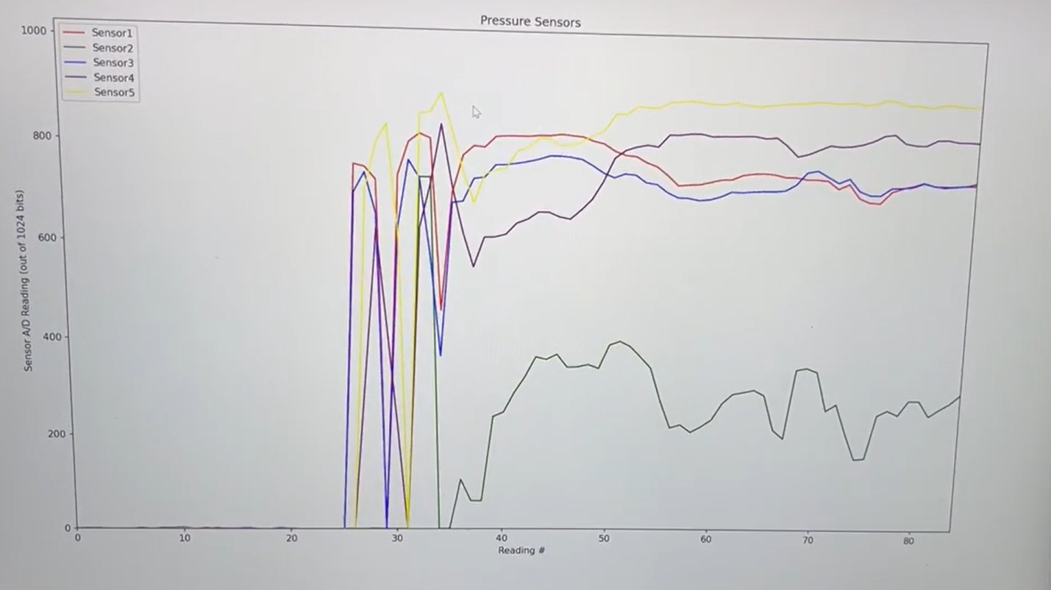
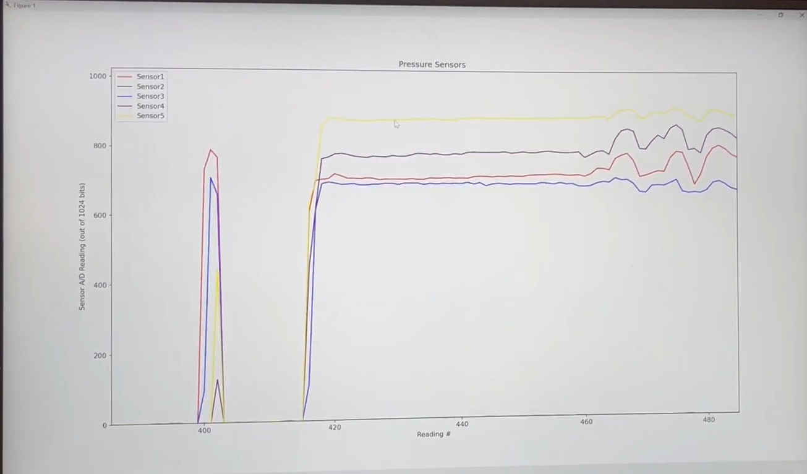
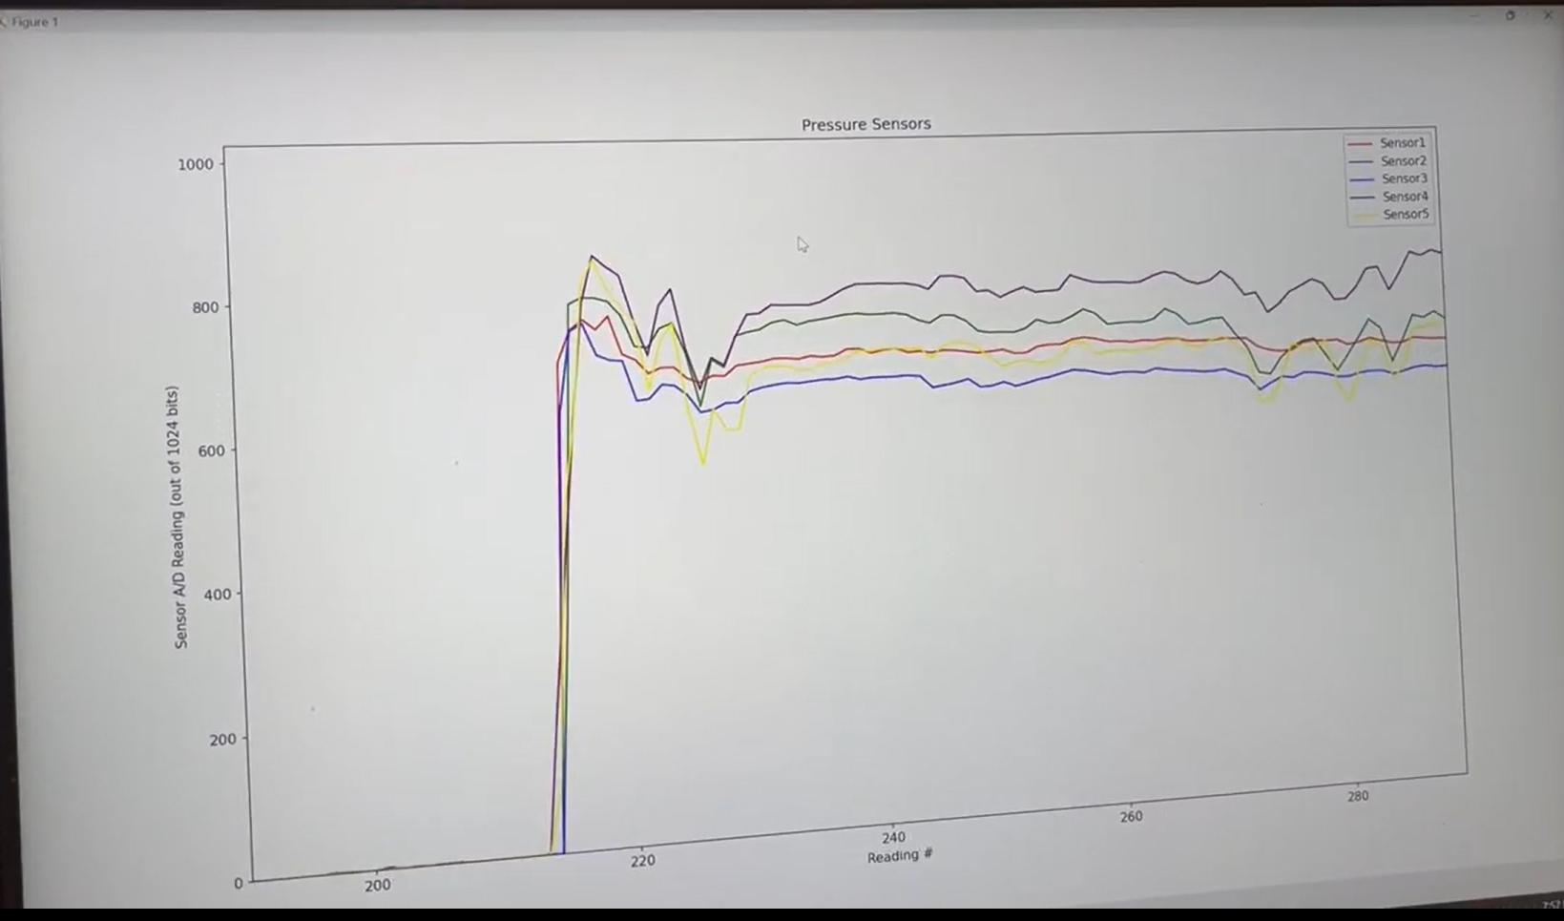
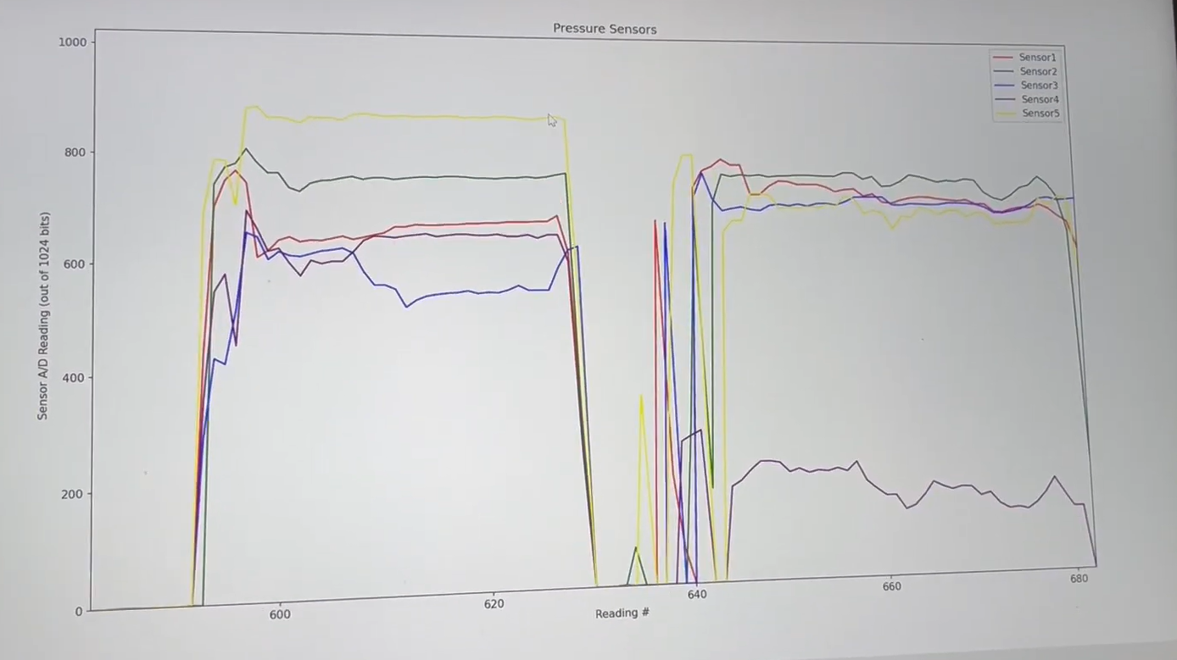

Sally – Average height arch
Tori – high arches (arch sensor not activated)
Angela – flat feet (near equal pressure across the foot)
Emaan – feet too small, heel sensor barely activated

Slide 15
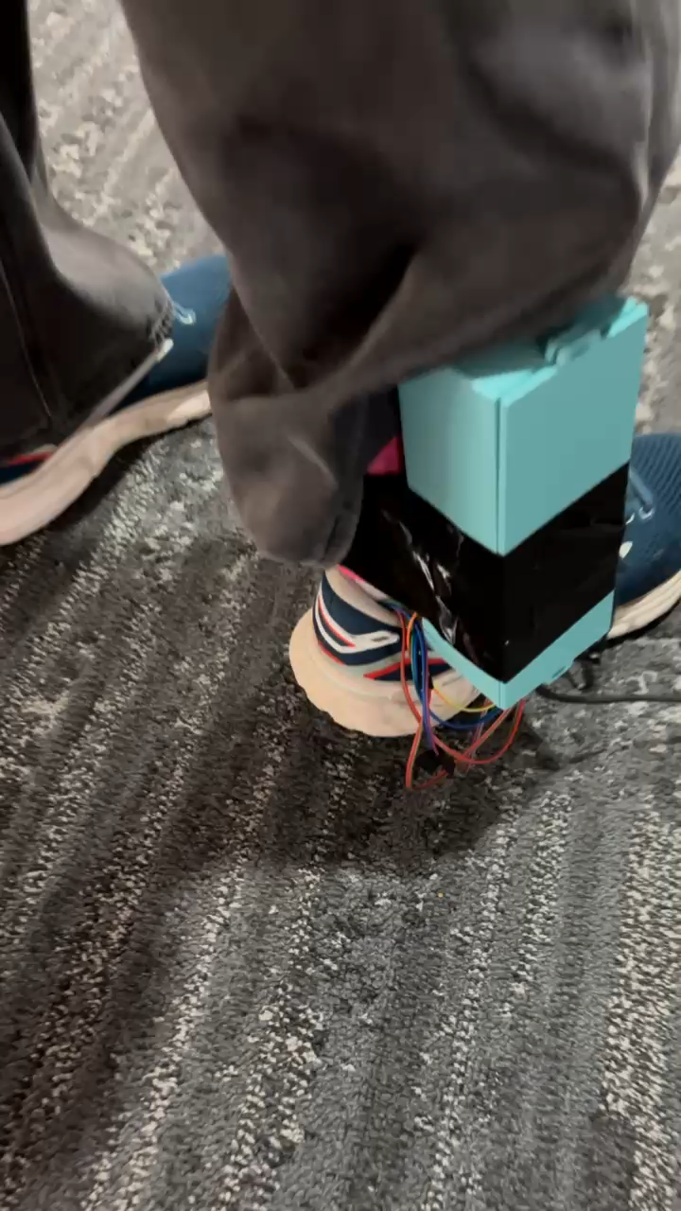
Walking Data Collection

Slide 16
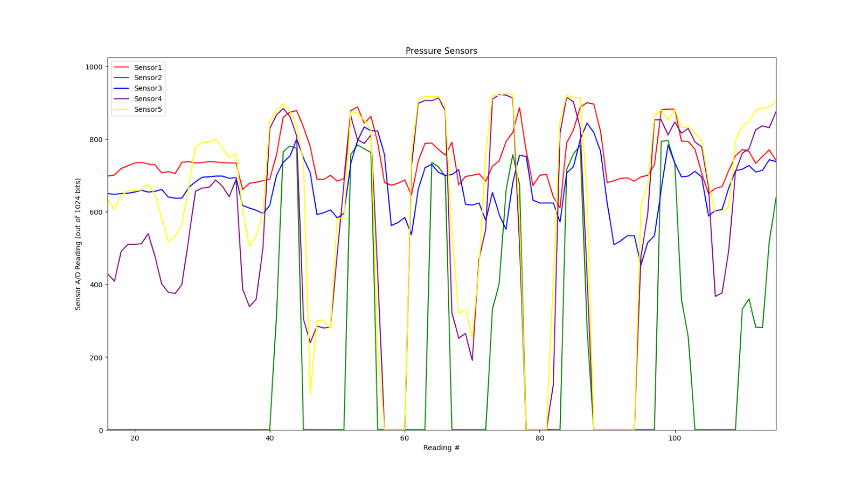
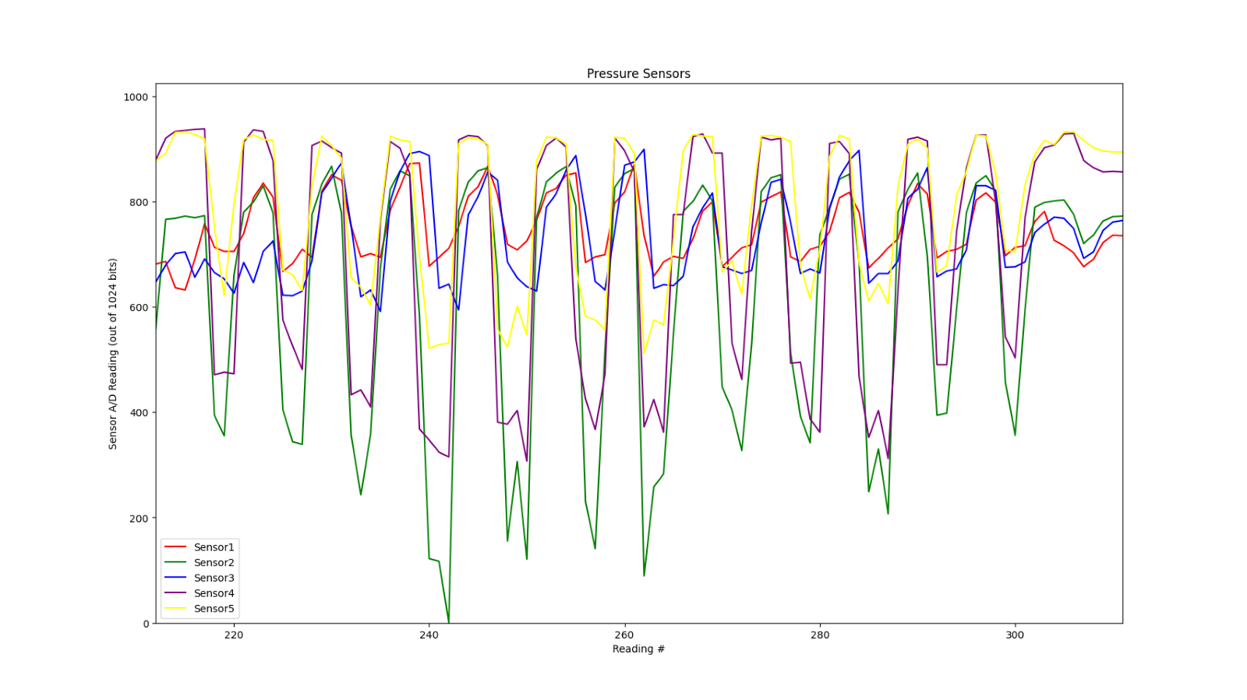
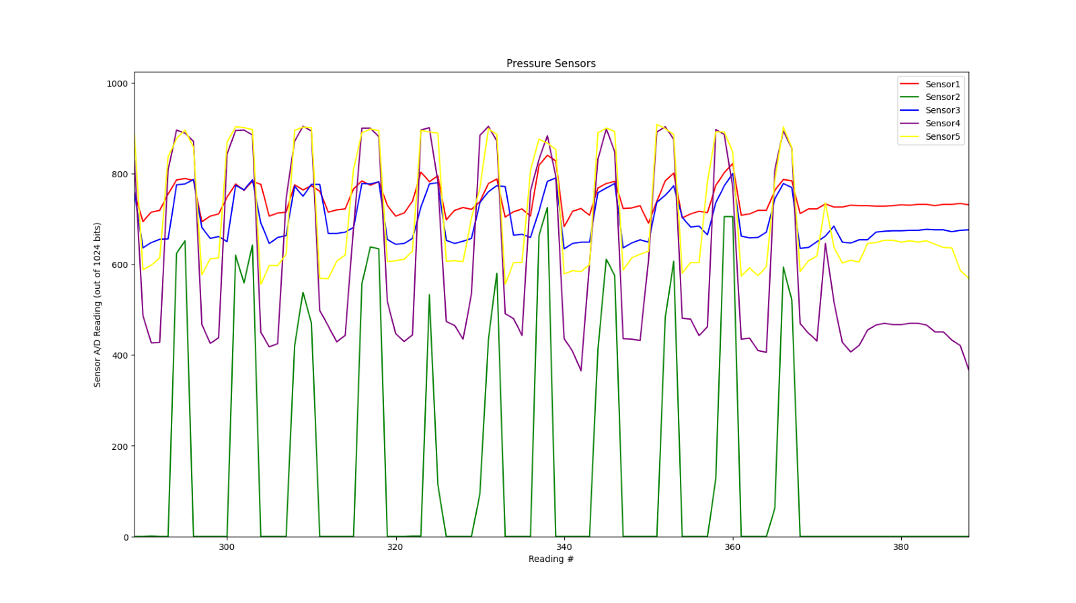
Additional Data- Walking
~775
= estimated arch reading average
~815
Tori's Walking Pattern
High arch height
~615
^Angela's Walking Pattern ^
^Sally's Walking Pattern ^
Low arch height (flat feet)
Normal arch height

Slide 17
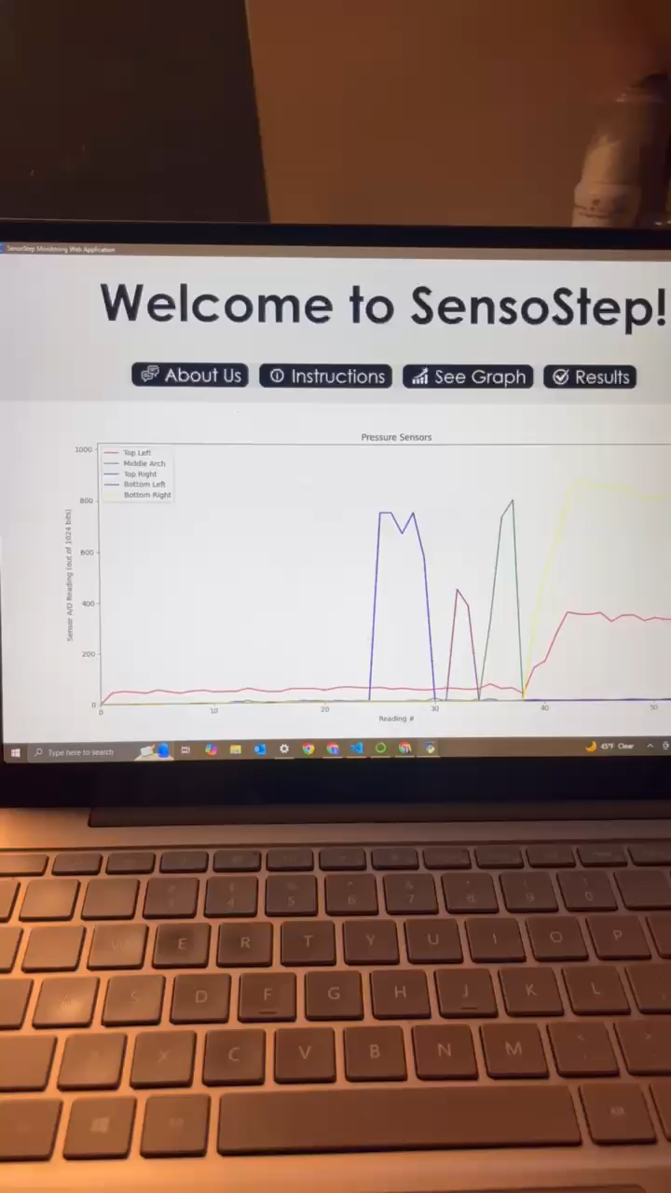
Connecting to the “App”
Done:
Used Python and Tkinter/CustomTkinter libraries to create a highly simplified app interface as shown on the right.
The graph that updates the pressure output was created using python, Arduino Nano 33 BLE integration using the matpylib and simplepyble libraries
Challenges:
The only issue was when the graph was run, the original python script from the previous slide would pop up along with the embedded graph in the app

Slide 18
Conclusion
Challenges:
We need a battery pack that effectively draws enough power to allow the product to stay connected for a longer period.
The app does need some refining to remove the pop-up when the graph starts plotting for a better user experience
Convert bites to more widely know unit
Display ratios between sensors instead of only a graph
Clunky/large apparatus to hold the wiring/battery
User-friendly interface à convert bites to a more common unit, calculate ratios between different sensors instead of displaying graph
Overall:
SensoStep did the job we set out for it to do, to track pressure distribution
This device can help understand a lot about a person’s foot and lower limb health
If we continued working on it, we would make the device more comfortable/easy to wear and set up because that is a very large selling point if put on the market

Slide 19
Material Cost
Materials | Cost
Sole Pad | $8.49
Sparkfun Kit | $99.95
Shoe | $10.00
Arduino Nano 33 BLE | $26.30
Leg Strap | $10.00
Sensors (5) | $10.00
Total Cost: $164.74

Slide 20
Thank you, any questions?

